Slide 1
A deeper understanding of your market and customer: extracting valuable, actionable insights from data
Presentation Made To East Africa Com
15th May 2019
Timothy Oriedo
Speaker, Author, MIT Certified Data Scientist, AI Expert
Tel: +254722816171 | Email: timothy.oriedo@predictiveanalytics.co.ke | @coachtimoriedo
Co-Founder Predictive Analytics Lab

Slide 2



Slide 3


Slide 4
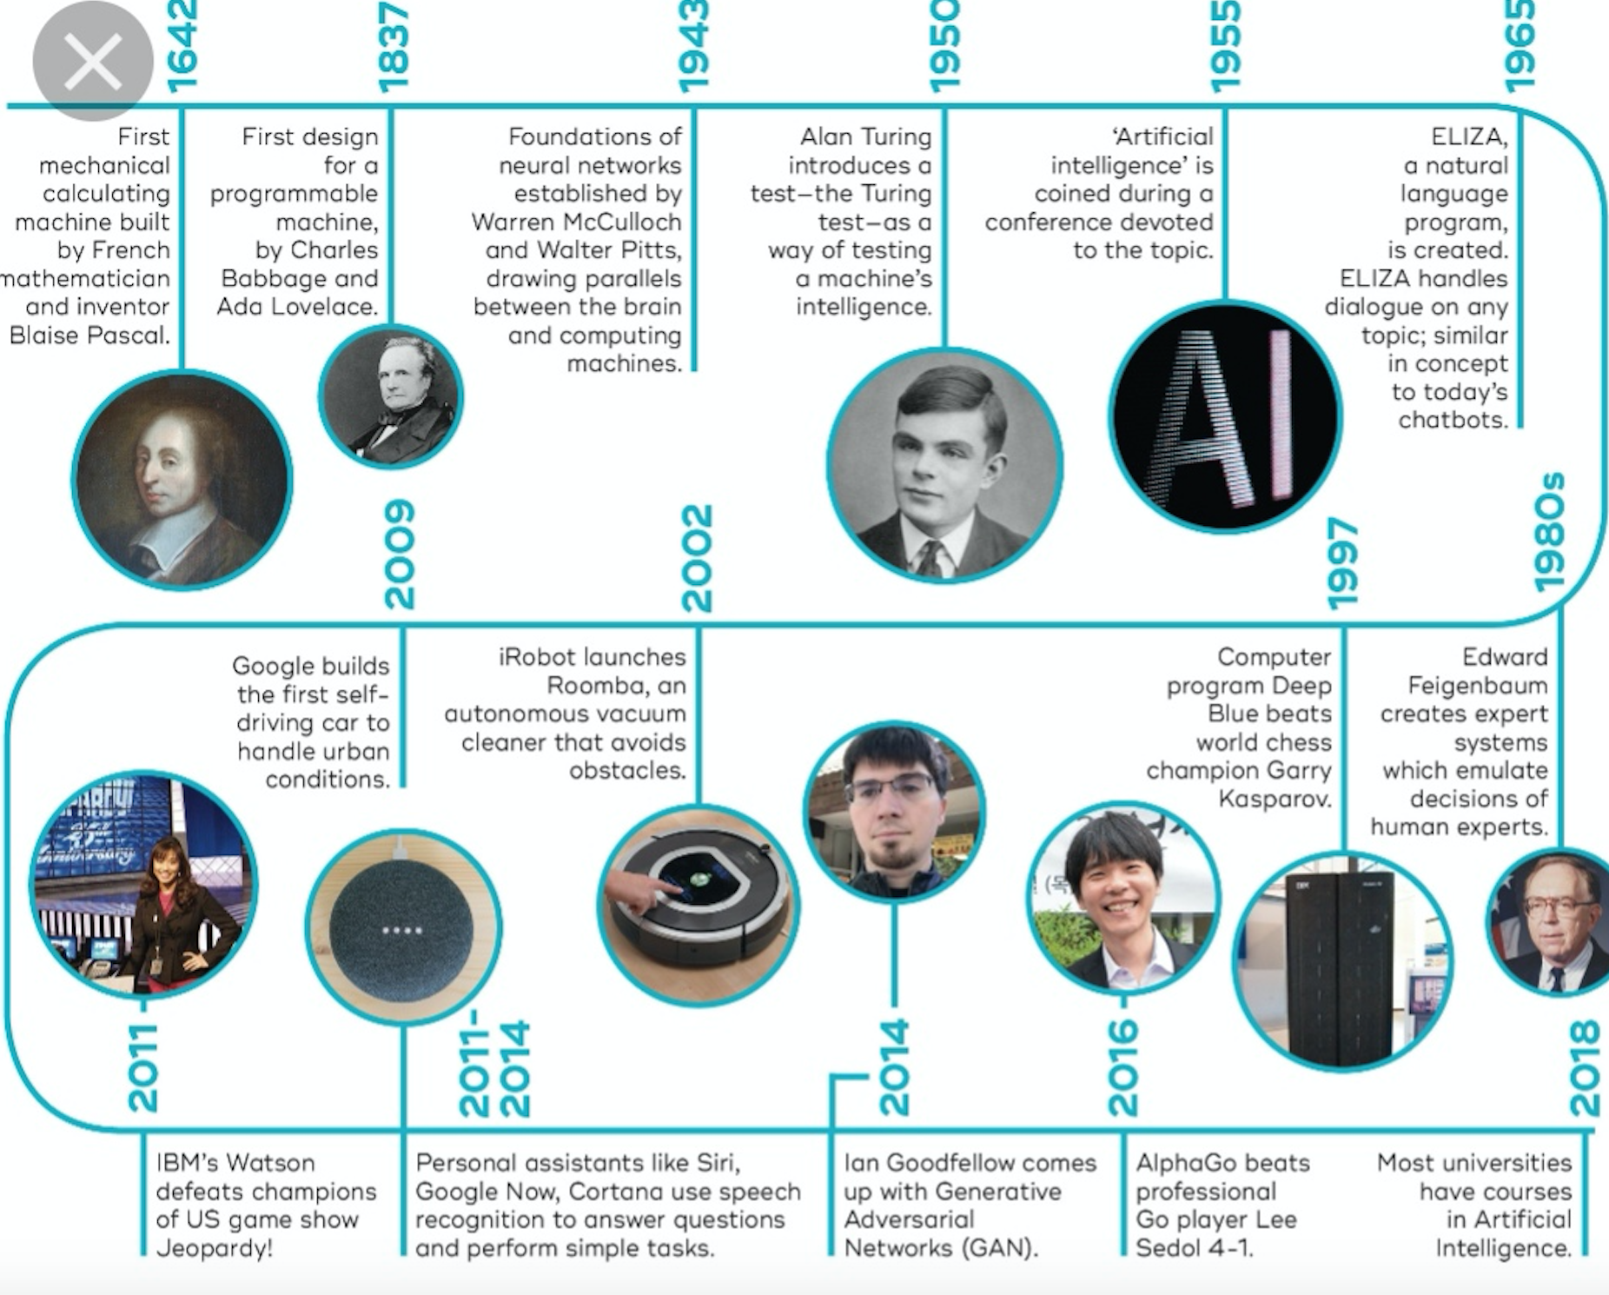

Slide 5
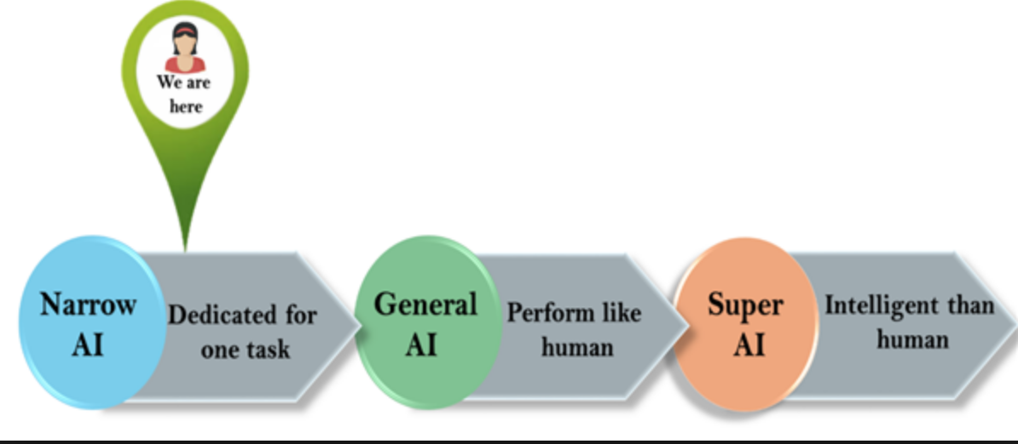

Slide 6
ROI: Only as good as the weakest link in the chain
1
Business Strategy
2
3
4
5
6
Machine Learning
Engineering
Data
People
Process
7
ROI Captured only as good as the weak link in the chain
Risk management, governance and controls

Slide 7
Variety, not volume, of data drives the most valuable insight
Customers who are most likely to leave us are…. | Data Sources
Calling as many times with complaints | Call Center RCD data
Not happy when talking to our call center agents | Call center (conversation Transcripts)
Not opening our market malls | Marketing systems
Have reduced business transactions with us | Core Banking System
Have given negative score in customer surveys | Customer Service System
Have access to competitive offerings | Market statistics (external sources)
Joining the dots across data sources will help us find patterns and correlations into potential customer churn

Slide 8














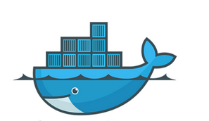









Piercing together tech stack will enable internal teams to seamlessly build, deploy and operate machine learning solutions at a scale
Semi structured
Applications
Data
Structured
Model Development
Publishing
Semi structured
Dev Ops
Governance
Collaboration
Audit store
xAI Risk control
Unstructured
Ingestion
Storage
Compute

Slide 9

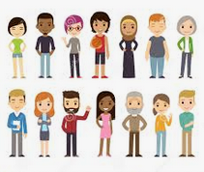
Cross-functional diverse CoE team co-located with business is a must
CoE
Value Realization
Product owner/ Business Translator
Business Analyst
Data Engineering
Data Engineer
Data Architect
Data Science
Data Science
Machine Learning Engineer
Design
Service Design
UX Design
Visualization Analyst
Infrastructure
Architect
Systems Integrator
People
Mindsets
ISTJ ISTP INTP ESTP
ISFP ISFJ ISFJ ESTJ
INFP INFJ INFJ ENFP
ESFJ ENTP ENTP ENFJ
Business team needs to be embedded into the work . Co-location is a must

Slide 10
A systematic approach required to capture the last translating insights into sustained value
Insights into actions
Driving adoption
Redesigned decision making journey
User friendly design
Clear decision making rights and accountabilities
Building data-driven decision making capabilities
Building data-driven culture : environment, role modelling , incentives and policies.
Visibility
Catalysts
How do we build trust for decision makers into the recommendations by machine learning models?
How do we ensure that decision makers are not blindly following the model recommendations?
Human
Machine
Collaboration

Slide 11
Build safe to scale governance and control environment
Data privacy
Bias Free
Data security
Fail safe
Risk accountability
Decision making governance
Explainable logarithm

Slide 12
